Slide 1
Parsing

Slide 2
outline
what’s parsing
Chart parsing
Earley parsing
PCFG
Probabilistic Chart parsing
lexicalized parser
training of PCFG
Probabilistic dependency parsing

Slide 3
references参考文献
nlu, fsnlp, slp有关章节
Eugene Charniak的文章：
http://www.cs.brown.edu/people/ec/
Michael Collins的文章：
http://www.ai.mit.edu/people/mcollins/publications.html
Dan Bikel的文章:
http://www.cis.upenn.edu/~dbikel/
Eisner的文章：three new probabilistic models for dependency parsing

Slide 4
What’s parsing什么是句法分析
definition：
  Recognition: determine if a sentence (string of words) belongs to a language
  Parsing: depicts the structure of a sentence explicitly
Parsing assumes we can represent the structure of a sentence by a certain formalism, which is usually specified by grammar

Slide 5
grammar formalisms
Two kind of common grammar formalisms:
  Phrase structure grammars (the Chomsky hierarchy), among which the Context Free Grammar is the most commonly used
  Dependency grammar by French Linguist Tesnière.
Parsing algorithms of course depends on grammar formalisms. However, CFG parsing should be mastered by everyone.

Slide 6
Definition of CFG
CFG (G) defined by a 4-tuple (N; T; P; S)
  N : set of nonterminal symbols
  T: set of terminal symbols N ∩ T = Ø;
  P : set of productions of the form A → β where A ∈ N and β is a string of symbols B_{i} with B_{i} ∈ (N ∩ T)
S: designated start symbol
Derivation: a string α => β iff β can be obtained from α by rewriting symbols in α by using one of the productions

Slide 7
Languages Defined by CFG
Derivations can be applied repeatedly (=*>).
Sentential form: any string of symbols that can be derived from the start symbol S
Sentence: a sentential form without nonterminals
Language: L(G)={ω|ω is a sentence}

Slide 8
A simple CFG
  S → NP VP det → the
  NP → det n n → man
  NP → det n PP n → girl
  VP → v NP n → telescope
  VP → v NP PP v → saw
  PP → p NP p → with

Slide 9
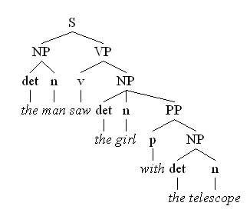
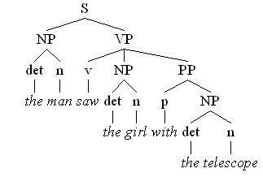
Two different parse trees for the sentence “the man saw the girl with the telescope”
The girl has the telescope
The man has the telescope

Slide 10
Grammar and ambiguity
文法和歧义
Because of the linearity and simplicity, natural language is full of ambiguity, which is the main difference from formal language and has great impact on parsing. 由于语言的线性结构及简约原则,自然语言充满歧义.这是与人工(一般是形式)语言的主要差别.分析算法必须考虑到这一点

Slide 11
Grammar and ambiguity
文法和歧义
Given a grammar such as CFG, the proper specification of rules is also important for parsers. Rules should be simple, easily understandable and unnecessary ambiguity should be avoided. 给定一种文法体系，如CFG，文法的写作也是重要的。要考虑到减少不必要的歧义,又要保证理解的自然性。非歧义的语言可以有歧义的文法。有歧义的语言只有歧义的文法。

Slide 12
Processing strategies
Top-down vs bottom-up processing
Depth-first vs breadth-first search
Left-to-right vs right-to-left scanning
Deterministic vs nondeterministic parsing

Slide 13
Top-down processing grows a tree from the root by repeat derivations until a sentence is derived, while bottom-up processing reduced a sentence to the start symbol by reverse applications of productions
Top - Down
s
s -> np, vp
s -> pron, vp
s -> John, vp
s -> John, v, np
s -> John, hit, np
s -> John, hit, det,n
s -> John, hit, the,n
s -> John, hit, the,cat
Bottom - Up
John, hit, the, cat
pron, hit, the, cat
pron, v, the, cat
pron, v, det, cat
pron, v, det, n
np, v, det, n
np, v, np
np, vp
s

Slide 14
CYK algorithm 算法
Applicable only to CNF(Chomsky Normal Form)文法
  all rules have one of the following two forms:
  A→a
  A→BC

Slide 15
Recognition of CNF
the CYK algorithm: use a 3-d array to remember the parsing states. Define P[i,j,A] = true iff A =*> w_{i} … w_{j}
for k := 1 to slen do
foreach A → w_{k} do P[k,k+1,A] := true
for span := 2 to slen – 1 do
for start := 1 to slen – 1 do
{ end := start + span;
for k := start + 1 to end – 1 do
foreach rule A → B C do
P[start,end,A] |= P[start,k,B] P[k,end,C]
}
if P[1,slen+1]=true then sentence is well-formed.
Changing P’s data structures to pointers can make a parser.

Slide 16
example：CNF grammar of {a^{n}b^{n}}
S → ε | AB | XB (ε is the empty string)
X → AT
T → AB | XB
A → a
B → b
Is x = aaabb in L(G )
Is x = aaabbb in L(G )

Slide 17
例子
分析过程画在表格中
end at start at | 1: aaabbb | 2: aaabbb | 3: aaabbb | 4: aaabbb | 5: aaabbb | 6: aaabbb
0:aaabbb
1:aaabbb
2:aaabbb
3:aaabbb
4:aaabbb
5:aaabbb

Slide 18
例子
1. Variables for length 1 substrings.
end at start at | 1: aaabbb | 2: aaabbb | 3: aaabbb | 4: aaabbb | 5: aaabbb | 6: aaabbb
0:aaabbb | A
1:aaabbb |  | A
2:aaabbb |  |  | A
3:aaabbb |  |  |  | B
4:aaabbb |  |  |  |  | B
5:aaabbb |  |  |  |  |  | B

Slide 19
例子
2. Variables for length 2 substrings.
end at start at | 1: aaabbb | 2: aaabbb | 3: aaabbb | 4: aaabbb | 5: aaabbb | 6: aaabbb
0:aaabbb | A | -
1:aaabbb |  | A | -
2:aaabbb |  |  | A | S,T
3:aaabbb |  |  |  | B | -
4:aaabbb |  |  |  |  | B | -
5:aaabbb |  |  |  |  |  | B

Slide 20
例子
3. Variables for length 3 substrings.
end at start at | 1: aaabbb | 2: aaabbb | 3: aaabbb | 4: aaabbb | 5: aaabbb | 6: aaabbb
0:aaabbb | A | - | -
1:aaabbb |  | A | - | X
2:aaabbb |  |  | A | S,T | -
3:aaabbb |  |  |  | B | - | -
4:aaabbb |  |  |  |  | B | -
5:aaabbb |  |  |  |  |  | B

Slide 21
例子
4. Variables for length 4 substrings.
end at start at | 1: aaabbb | 2: aaabbb | 3: aaabbb | 4: aaabbb | 5: aaabbb | 6: aaabbb
0:aaabbb | A | - | - | -
1:aaabbb |  | A | - | X | S,T
2:aaabbb |  |  | A | S,T | - | -
3:aaabbb |  |  |  | B | - | -
4:aaabbb |  |  |  |  | B | -
5:aaabbb |  |  |  |  |  | B

Slide 22
例子
5. Variables for length 5 substrings.
end at start at | 1: aaabbb | 2: aaabbb | 3: aaabbb | 4: aaabbb | 5: aaabbb | 6: aaabbb
0:aaabbb | A | - | - | - | X
1:aaabbb |  | A | - | X | S,T | -
2:aaabbb |  |  | A | S,T | - | -
3:aaabbb |  |  |  | B | - | -
4:aaabbb |  |  |  |  | B | -
5:aaabbb |  |  |  |  |  | B

Slide 23
例子
6. Variables for aaabbb. ACCEPTED!
end at start at | 1: aaabbb | 2: aaabbb | 3: aaabbb | 4: aaabbb | 5: aaabbb | 6: aaabbb
0:aaabbb | A | - | - | - | X | S,T
1:aaabbb |  | A | - | X | S,T | -
2:aaabbb |  |  | A | S,T | - | -
3:aaabbb |  |  |  | B | - | -
4:aaabbb |  |  |  |  | B | -
5:aaabbb |  |  |  |  |  | B

Slide 24
Chart Parsing
General Principles:
  A Bottom-Up parsing method
    – Construct a parse starting from the input symbols
    – Build constituents from sub-constituents
    – When all constituents on the RHS of a rule are matched, create a constituent for the LHS of the rule
  The Chart is a data structure that allows storing of partial analyses, so that they can be shared. (like dynamic programming)

Slide 25

chart example
John likes Mary
S-> NP VP VP -> v NP
NP -> John | Mary v -> likes

Slide 26
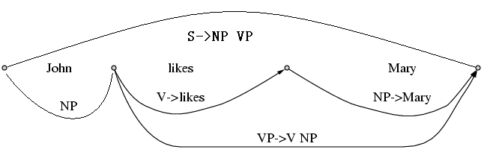

Slide 27
Dotted rules点规则
Dotted rules are used to represent the parsing states in a left-to-right scanning strategy.
A dotted rules is composed of 4 parts:
（1）a CFG rule
（2）the dot·(to its left is analyzed parts and to its right is the parts to be analyzed)
（3）i : the start index of analyzed parts
（4）j : the end index of analyzed parts
i≤j
e.g.：S → NP·VP <1,4>
signals that an NP is found between word 1 and 4 in search for a S, and a VP is expected

Slide 28
Active arc: dotted rules where the dot is not in the rightmost position. 如果点不在产生式的最右部，在分析中称为“活动弧”
chart parsing is the process of producing active arcs and moving the dot to the right
Dotted rules are also called items in compiler theory

Slide 29
Chart Parsing
  Data structures used by the algorithm:
    – The Key: the current constituent we are attempting to “match”
    – An Active Arc: a grammar rule that has a partially matched RHS
    – The Agenda: Keeps track of newly found unprocessed constituents
    – The Chart: Records processed constituents (non-terminals) that span substrings of the input

Slide 30
The Chart Parsing Algorithm
parsing input x = x₁…x_{n}
For i=1 to n do
  1. Find all POS of the current word = x_{i}
  2. Initialize Agenda with all POS of the word: C<p_{i},p_{i+1}>
  3. Pick a Key C< p_{j},p_{k} > from the Agenda
  4. For each grammar rule of form A → CX₁…X_{m}, add
  A → • CX₁…X_{m}< p_{j} ,p_{j}> to the list of active arcs
  5. Extend any existing active arcs with the Key
  6. Add LHS constituents of newly completed rules to the Agenda
  7. Add the Key to the Chart
  8. If Agenda not empty – go to (3), else go to (1)
  9. Find all the constituents S<1,n+1>

Slide 31
Extending Active Arcs
Extending Active Arcs with a Key:
Each Active Arc has the form:
    A → X₁…•C…X_{m} < p_{i},p_{j}>
- A Key constituent has the form: C →…• <p_{j},p_{k}>
- When processing the Key C →…• <p_{j},p_{k}>, we search the active arc list for an arc A → X₁…•C…X_{m}< p_{i},p_{j}>, and then create a new active arc
A → X₁…C • …X_{m} < p_{i},p_{k}>
- If the new active arc is a completed rule:
A → X₁…C • < p_{i},p_{k}>,
then we add A → … • < p_{i},p_{k}> to the Agenda
- After “using” the key to extend all relevant arcs, it is entered into the Chart

Slide 32

extending an active arc:合并规则
A→α•Bβ<i:j>, B→γ•<j:k> ➔
A→αB•β<i:k>

Slide 33
Chart Parsing - Example
The Grammar:
  (1) S → NP VP
  (2) NP → ART ADJ N
  (3) NP → ART N
  (4) NP → ADJ N
  (5) VP → AUX VP
  (6) VP → V NP

Slide 34
Chart Parsing - Example
The input:
  “x = The large can can hold the water”
POS of Input Words:
  the: ART
  large: ADJ
  can: N, AUX, V
  hold: N, V
  water: N, V

Slide 35
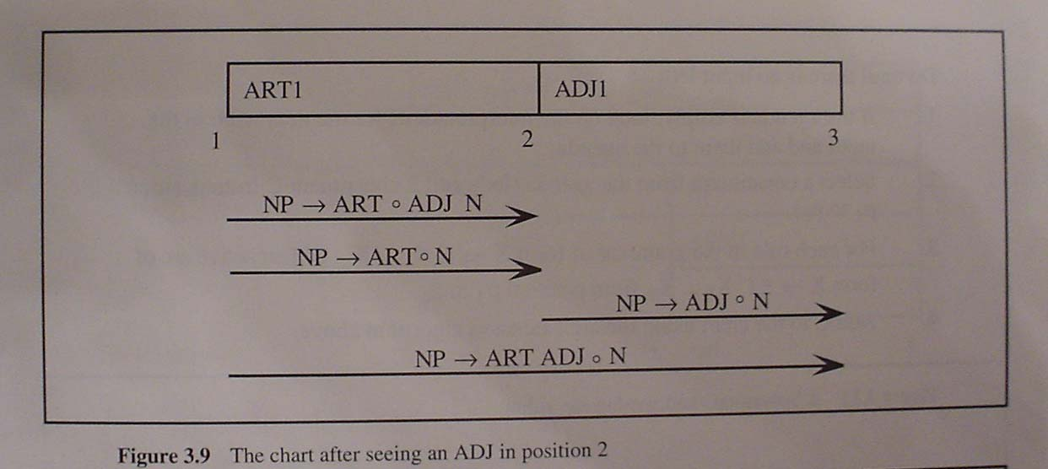
The large can can hold the water

Slide 36
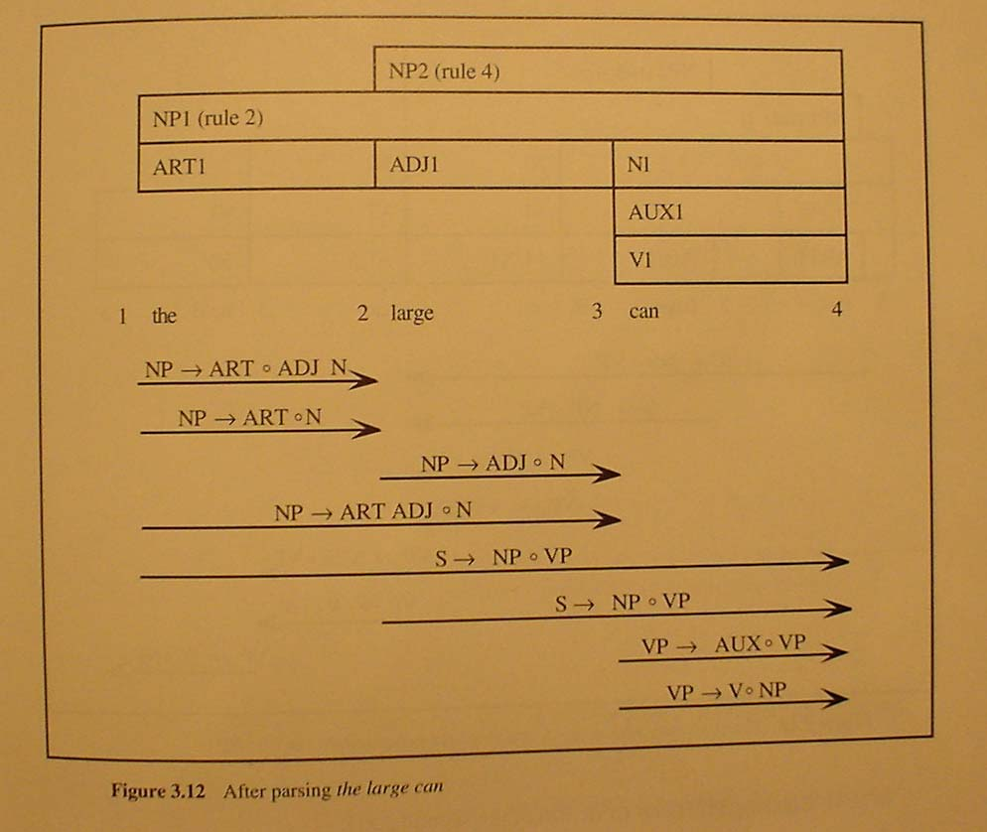
The large can can hold the water

Slide 37
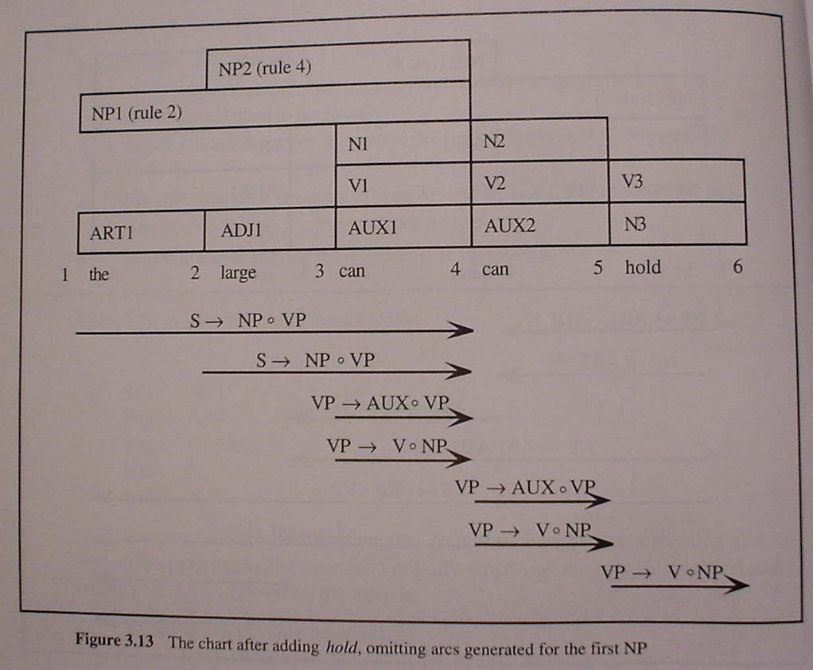
The large can can hold the water

Slide 38
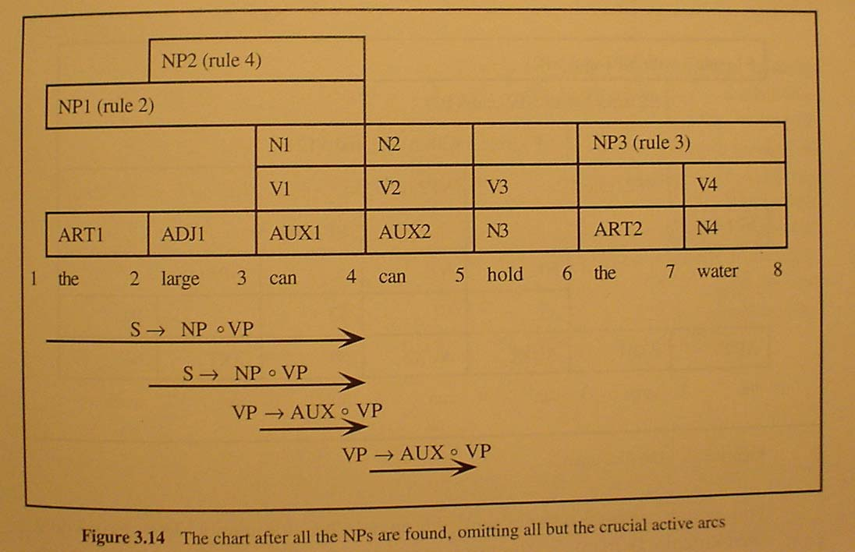
The large can can hold the water

Slide 39
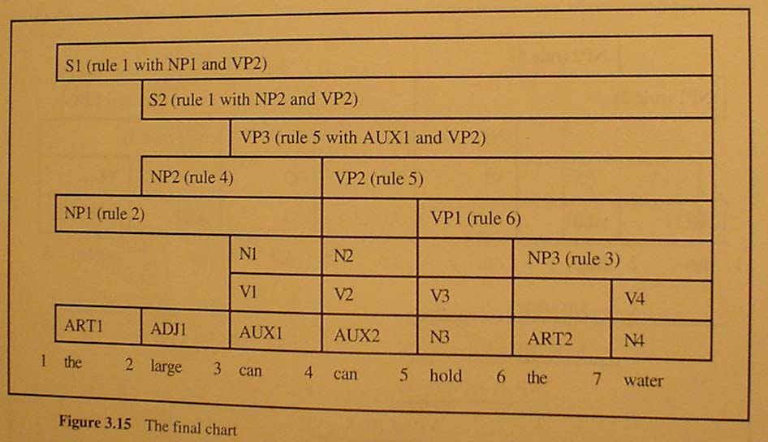
The final Chart

Slide 40
how is agenda organized?
as a stack
as a queue

Slide 41
blind parsing
adding an active arc may be blind and useless
the large can can hold hold the water
the arc AUX→.can is added and extended, as is V →.can;
Vp → .AUX VP, VP → .V NP ......
but there is no derivation S → ART ADJ AUX β

Slide 42
so a lot of useless constituents are generated, though only once (cf. may be generated many times if backtracking )

Slide 43
bottom up charting parsing can be guided by done top-down filtering
this is called “Earley parsing” because Jay Earley first described it in 1968 in his dissertation.

Slide 44
implementation of earley parsing as top-down (predicative) chart parser
  For each non-terminal A, define First(A) = the set of all leftmost non-terminals derivable from A ( including A)
  Compute in advance First(A) for all non-terminals A
  When processing the key C<p_{j},p_{k}> we look for grammar rules that form an active arc A → •C X₂…X_{m}< p_{j} ,p_{j}>
  Add the active arc only if A is predicted: there already exists an active arc B → X₁…•D…X_{m}<p_{k} , p_{j}> such that A ∈ First(D)
  Initial active arcs: arcs of the form A → • C X₂…X_{m}<1,1>, A ∈ First(S)

Slide 45
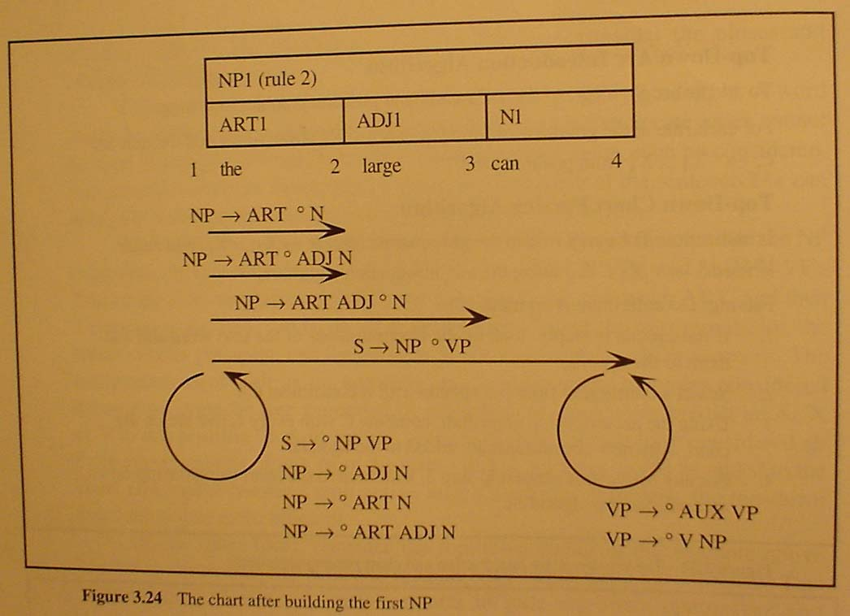
Earley chart Parser - Example

Slide 46
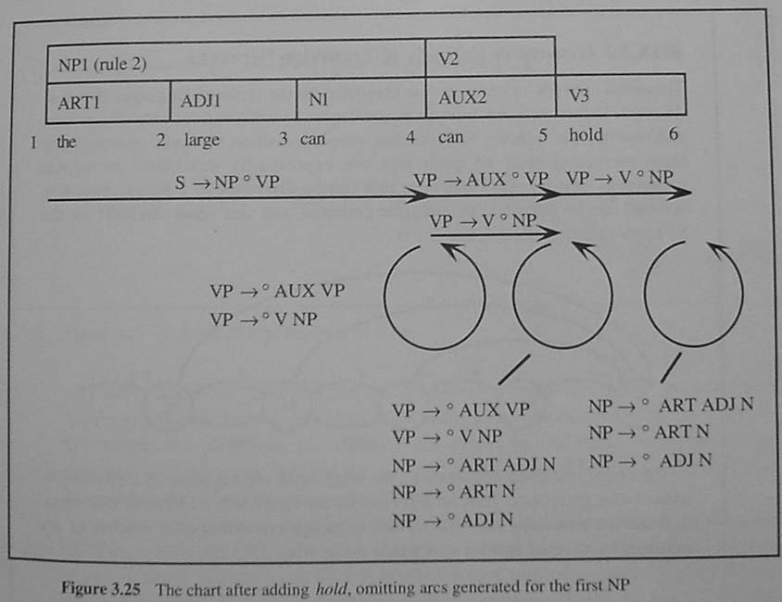
The large can can hold the water

Slide 47
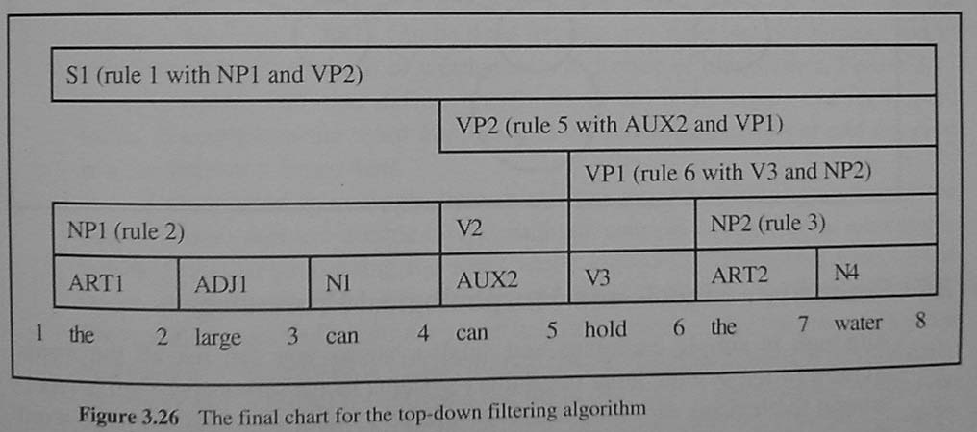
The large can can hold the water

Slide 48
Advantages of Earley parser
Bottom-up matching combined with top-down prediction lead to high efficiency (though it is still O(n₃). 自顶向下预测，同时自底向上匹配单词，效率很高，与编译中介绍的LR(1)相比，一样具有有效前缀性质，但是没有预计算功能(非表驱动)
Earley Algorithm can handle any CFG. Earley算法可以对任意CFG进行分析，但是LR处理的只是LR(k)文法

Slide 49
homework
Rule based parsing is not suitable for natural language because of ambiguity but it is still the foundation for probabilistic parsing. Download and read the source code of a chart parser. (e.g. from http://opennlp.sourceforge.net/). You can also download my implementation of a chart parser from the course website.

Slide 50
Probabilistic CFG
Probabilistic/Stochastic CFG (PCFG or SCFG)
PCFG has extra parameter (N; T; P; S; D)
D: function that assigns probabilities to each rule in P
  A → β [p]
  p is the probability of the rule (A → β)
Note that p for all expansions of a nonterminal A must sum to 1

Slide 51
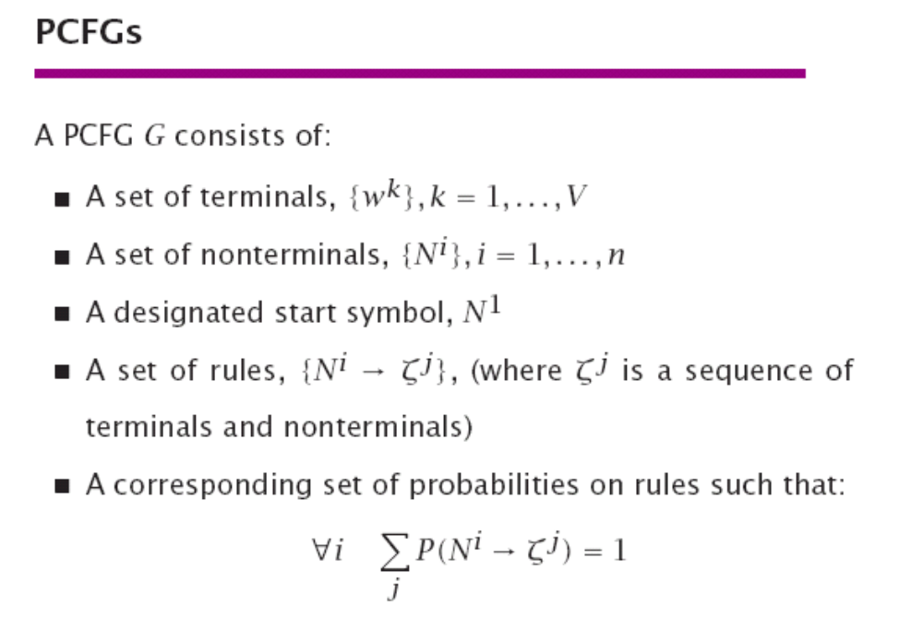

Slide 52
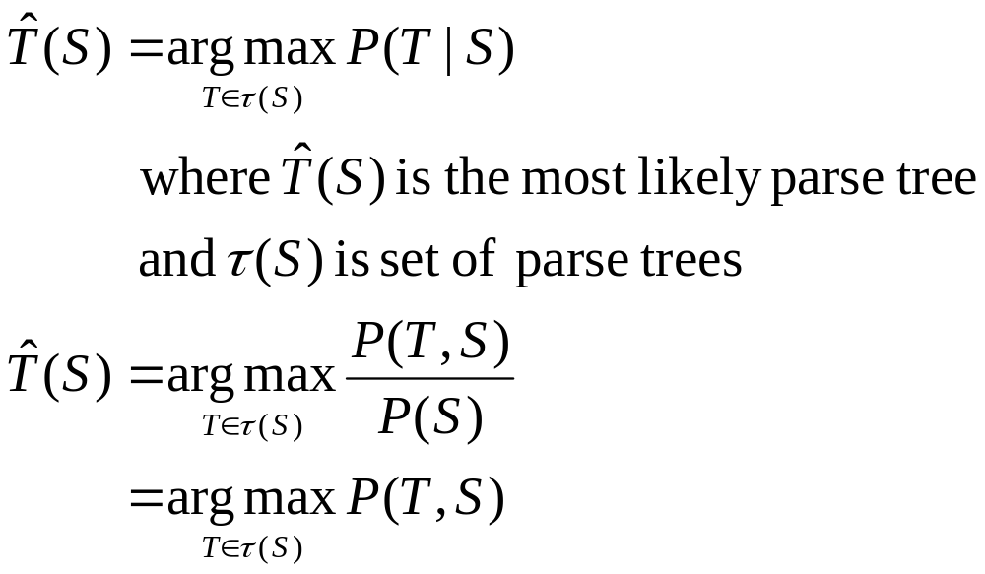
Use of PCFG
We use probabilities to disambiguate parses
Choose most likely parse from multiple parses

Slide 53
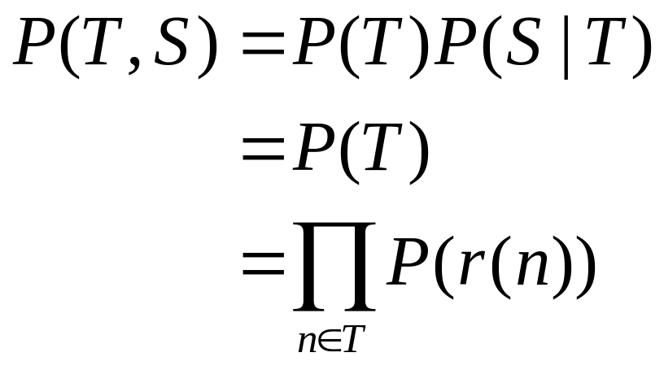
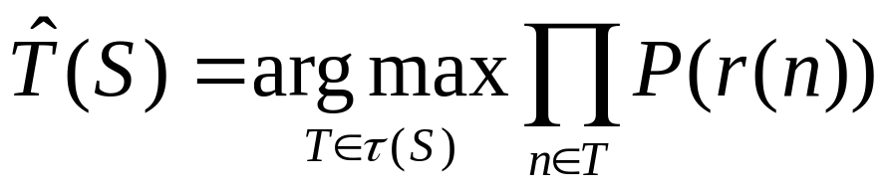
P(T,S)
n is a node in parse tree
r(n) is the rule that expands n
P(S|T) = 1, since a parse tree T yields sentence S

Slide 54
PCFG
S→ NP VP 1
VP→ V NP 0.7
VP → V NP PP 0.3
NP → Det n 0.4
NP → Det n PP 0.6
PP → p NP 1
Lexicon
det → the 1
n → man 0.4
n → girl 0.3
n → telescope 0.3
v → saw 1
p → with 1

Slide 55
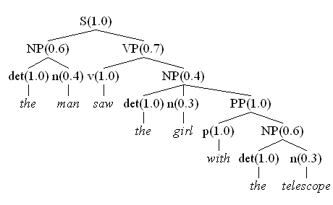
P(Tree1) = 1.0 x 0.6 x 1.0 x 0.4 x 0.7 x 1.0 x 0.4 x 1.0 x 0.3 x 1.0 x 1.0 x 0.6 x 1.0 x 0.3
= 0.0036288

Slide 56
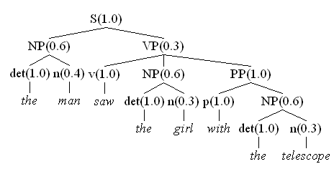
P(Tree2) = 1.0 x 0.6 x 1.0 x 0.4 x 0.3 x 1.0 x 0.6 x 1.0 x 0.3 x 1.0 x 1.0 x 0.6 x 1.0 x 0.3
= 0.0023328

Slide 57
Is PCFG really useful？
PCFG can let us select a parse with highest probability. 可以让我们选择分析树。
But the true tree is context dependent, but our probability model is not, so the choice is not always correct. 但是我们从上一个例子（在不同的上下文应该选择不同的分析树）看到，PCFG选择的不一定正确。

Slide 58
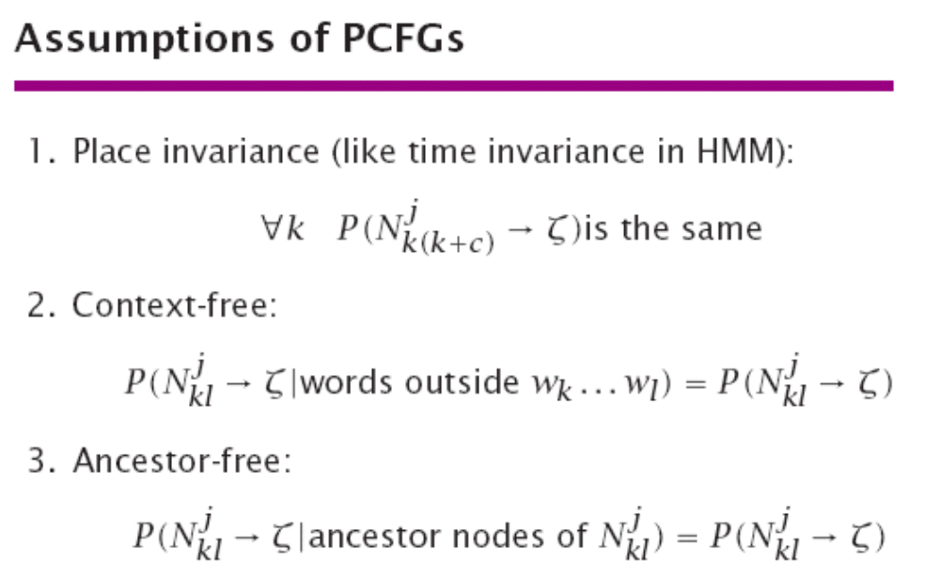

Slide 59
PCFG’s problems
PCFG cannot describe context-sensitivity. PCFG无法描述自然语言句法规则的两种现象
  Structural dependency 结构相关性
  Lexical dependency 词汇相关性

Slide 60
Structural Dependencies
E.g. Syntactic subject of a sentence tends to be a pronoun
  Subject tends to realize the topic of a sentence
  Topic is usually old information
  Pronouns are usually used to refer to old information
  So subject tends to be a pronoun
  In Switchboard corpus:
    91% of subjects in declarative sentences are pronouns
    66% of direct objects are lexical (nonpronominal)

Slide 61
The same nonterminal has different derivation probability in different positions.同一个非终结符在不同的位置的推导概率不一样。比如，代词多用作主语。
The derivation of the same nonterminal is not independent, e.g. the same NP in ditransitive constructions. 不同产生式的推导不是独立的。比如在双宾语结构中，第一个宾语一般是简单宾语。

Slide 62
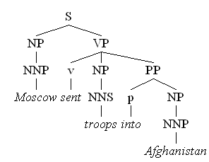
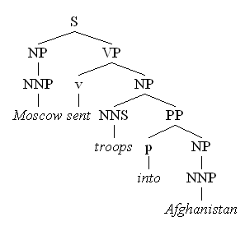
Lexical Dependencies
Two parse trees for the sentence “Moscow sent troops into Afghanistan”
句法规则的推导依赖于具体单词（再比如rely on等搭配）。
Correct parse
Incorrect parse
Notes:
The verb send subcategorises for a destination, which could be a PP headed by “into”

Slide 63
In a word, natural language is context-sensitive. 一句话，自然语言是上下文相关的。概率的计算与上下文有关。这说明PCFG只是一个非常粗糙的概率模型，不一定适合描述自然语言。也许我们需要PCSG？（思考）
We need to improve on the PCFG model.我们下面会用条件概率来改进PCFG模型
But let’s see how to get probabilities但是首先我们看一看这些推导概率是如何得到的？

Slide 64
Getting the Probabilities
From an annotated database
  E.g. the Penn Treebank
  To get the probability for a particular VP rule just count all the times the rule is used and divide by the number of VPs overall
  Simple?

Slide 65
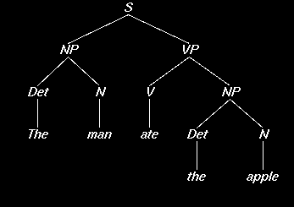
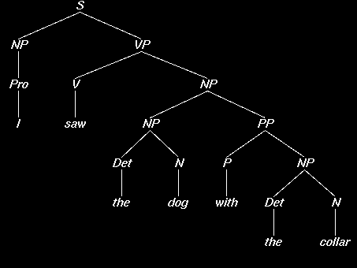
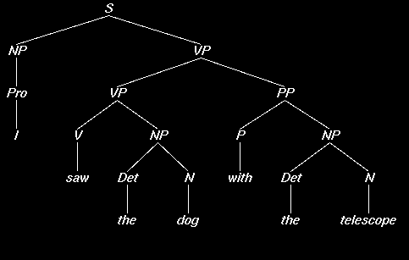
S → NP VP
3
NP → Pro
2
NP → Det N
6
NP → NP PP
1
VP → V NP
VP → VP PP
PP → P NP
3
1
2

Slide 66
S → NP VP
3
/ 3 = 1.0
NP → Pro
2
/ 9 = 0.22
NP → Det N
6
/ 9 = 0.67
NP → NP PP
1
/ 9 = 0.11
VP → V NP
VP → VP PP
PP → P NP
3
/ 4 = 0.75
1
/ 4 = 0.25
2
/ 2 = 1.0

Slide 67
S → NP VP
1.0
NP → Pro
0.22
NP → Det N
0.67
NP → NP PP
0.11
VP → V NP
VP → VP PP
PP → P NP
0.75
0.25
1.0

Slide 68
Evaluating Parsing Accuracy
A treebank also makes evaluation easier
Few sentences are assigned a completely correct parse by any currently existing parsers. Rather, evaluation is done in terms of the percentage of correct constituents.
[Label, Start, Finish]
A constituent is a triple, all of which must be in the true parse for the constituent to be marked correct.

Slide 69
Evaluating Constituent Accuracy
Let C be the number of correct constituents produced by the parser over the test set, M be the total number of constituents produced, and N be the total in the correct version
Precision = C/M
Recall = C/N
Both are important measures.

Slide 70
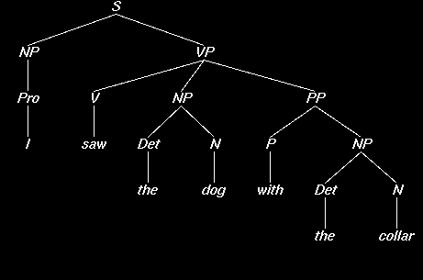
Parser Evaluation Using the Penn Treebank
Labeled Precision and Recall of constituents
Our parser says: The Treebank says:

Slide 71
Counting Constituents
S 1 7 S 1 7
NP 1 1 NP 1 1
VP 2 7 VP 2 7
NP 3 4 NP 3 7
PP 5 7 NP 3 4
NP 6 7 PP 5 7
NP 6 7

Slide 72
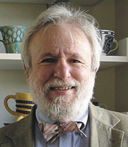
Parsing Results [Charniak]
Method Prec/Rec
    [average]
PCFG 75%

Slide 73
Implementing PCFG on chart parsing
Bottom-up dynamic programming approach
Assign probabilities to constituents as they are completed and placed in the table
Use the max probability for each constituent going up the tree
We can also add nbest parsing easily

Slide 74
Using the Maxima
suppose we want calculate P(NP)
what if there are multiple NPs for the span of text in question (i to j)?
Take the max!
probs for other kinds of constituents for the same span are also calculated, of course
N words w₁…w_{n}
Array α[i,j,A] holds the maximum probability for a constituent with non-terminal A spanning words w_{i+1}…w_{j}
Maximum probability parse will be α[0,n,S]

Slide 75
Better PCFG: lexicalized parsing
To do better, it is necessary to condition probabilities on the actual words of the sentence. This makes the probabilities much tighter:
p(V NP NP|VP) = 0.00151
p(V NP NP|VP(said)) = 0.00001
p(V NP NP|VP(gave)) = 0.01980

Slide 76
Heads
Make use of notion of the head of a phrase, e.g.
  The head of an NP is its noun
  The head of a VP is its verb
  The head of a PP is its preposition
Phrasal heads
  Define most important characteristics of the phrase
  Can ‘take the place of’ whole phrases, in some sense
  Phrases are generally identified by their heads

Slide 77
a parse with heads marked

Slide 78
How to get p(V NP NP|VP(gave)) ?
count the number of times rule (VP -> V NP NP) is used where the head of V is “gave” and divide it by the number of times “gave” is used as the head of VP in a treebank
  P(VP → VB NP NP | VP(gave))
  = C(VP(gave) → VB NP VP)/ Σ_{β} C(VP(gave) → β)
it captures the notion of subcategorization of “gave”

Slide 79
smoothing
If a verb does not appear in a corpus, does it mean that its lexicalized probability is 0?
For many verbs, even it appears in the corpus, its lexicalized probability is very small for any treebank, so smoothing (usu. backoff) is needed, e.g.

Slide 80
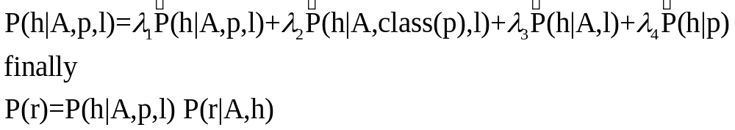
More refined model: add head probability
The rule prob. is composed of head prob. and then rule decomposition.
We think that given a constituent, its head h is dependent only on its category A, and its parent’s category p, and its parent’s head l, thus

Slide 81
other lexical preferences
consider pp-attachment: determine whether a preposition modifies a preceding noun or a verb.
Consider:
  Ate spaghetti with gusto
  Ate spaghetti with marinara
The affinity of gusto for eat is much larger than its affinity for spaghetti
On the other hand, the affinity of marinara for spaghetti is much higher than its affinity for ate

Slide 82
But not a Head Probability Relationship
Note the relationship here is more distant and doesn’t involve a headword since gusto and marinara aren’t the heads of the PPs
Vp (ate)
Vp(ate)
Np(spag)
Vp(ate)
Pp(with)
np
Pp(with)
v
np
v
Ate spaghetti with gusto
Ate spaghetti with marinara

Slide 83
so we need a more general model:
P(rule|context)
where the context can be: head, parent’s head, grandparent’s head, ...
not only heads, anything useful may be conditioned upon
this is getting context-sensitive!

Slide 84
Lexicalized Probabilities [Charniak]
p(prices | n-plural) = .013
p(prices | n-plural, NP) = .013
p(prices | n-plural, NP, S) = .025
p(prices | n-plural, NP, S, v-past) = .052
p(prices | n-plural, NP, S, v-past, fell) = .146

Slide 85
Parsing Results [Charniak]
Method Prec/Rec
PCFG 75%
PCFG with lexicalization 87.5%

Slide 86
How to evaluate
Wall Street Journal (WSJ) section
  50,000 sentences, 1 million words
    POS tags and constituent trees
  Divided in sections
    Training: sections 2 – 21 (~40,000 sentences)
    Testing: section 23 (~2,400 sentences)
    Development: section 22

Slide 87
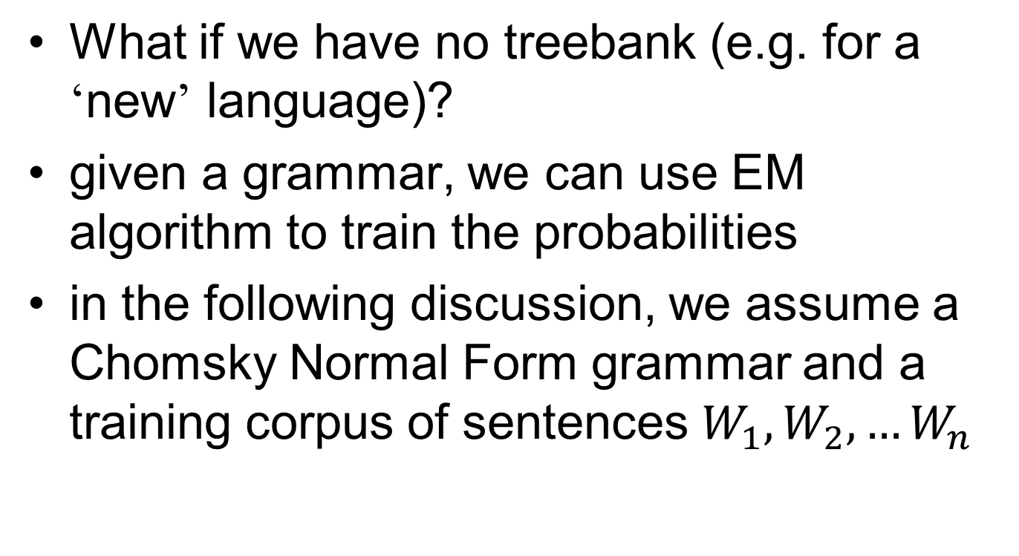
PCFG training

Slide 88
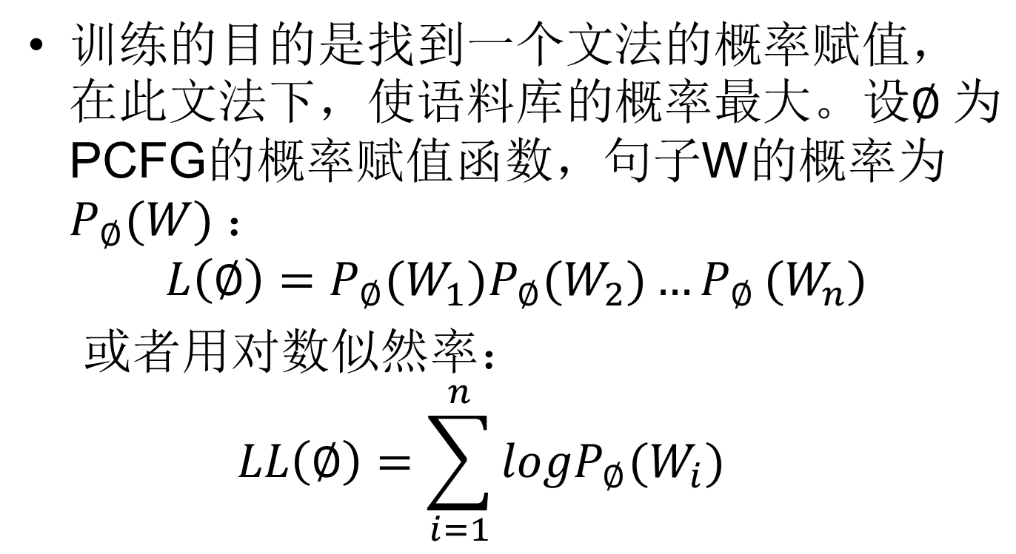

EM algorithm 算法

Slide 89



Definitions
Inside probability: total prob of generating words w_{i}…w_{j} from non-terminal A.
Outside probability: total prob of beginning with the start symbol S and generating
可以把这两个概率和HMM中的forward和backward函数相类比

Slide 90
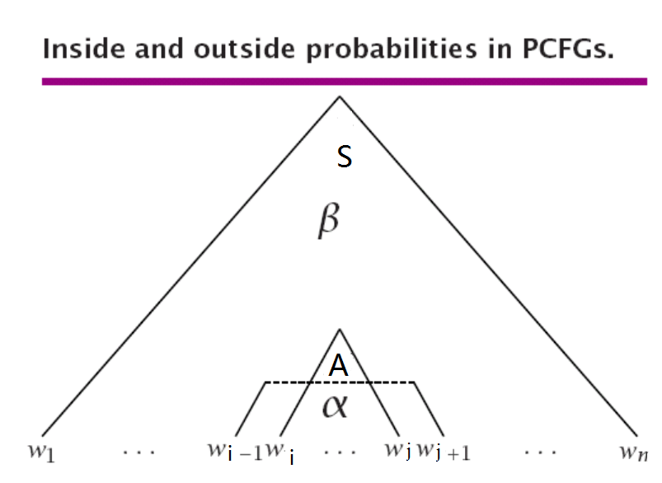

Slide 91
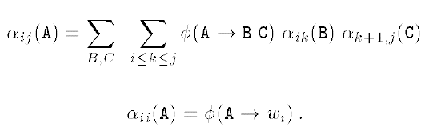

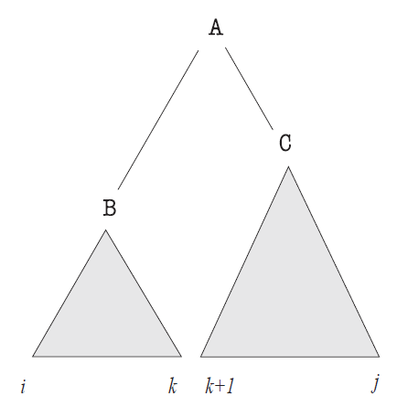
计算inside和outside概率

Slide 92

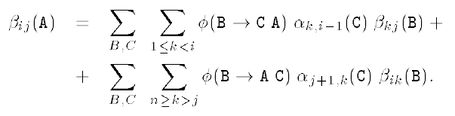
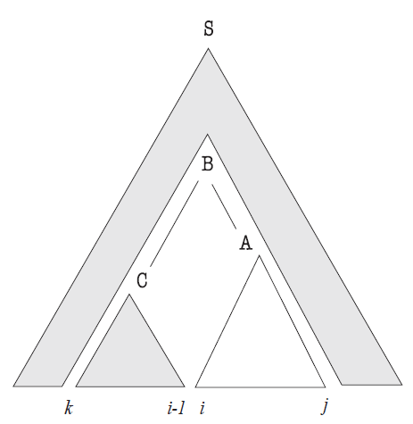
计算inside和outside概率

Slide 93
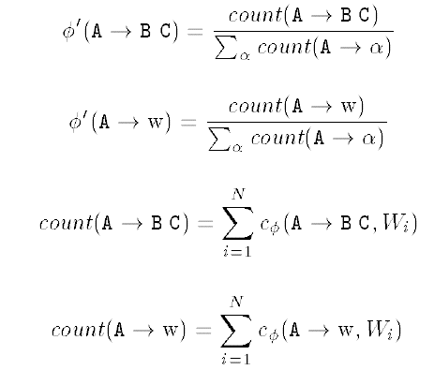
从inside和outside概率计算新期望值

Slide 94



从inside和outside概率计算新期望值

Slide 95
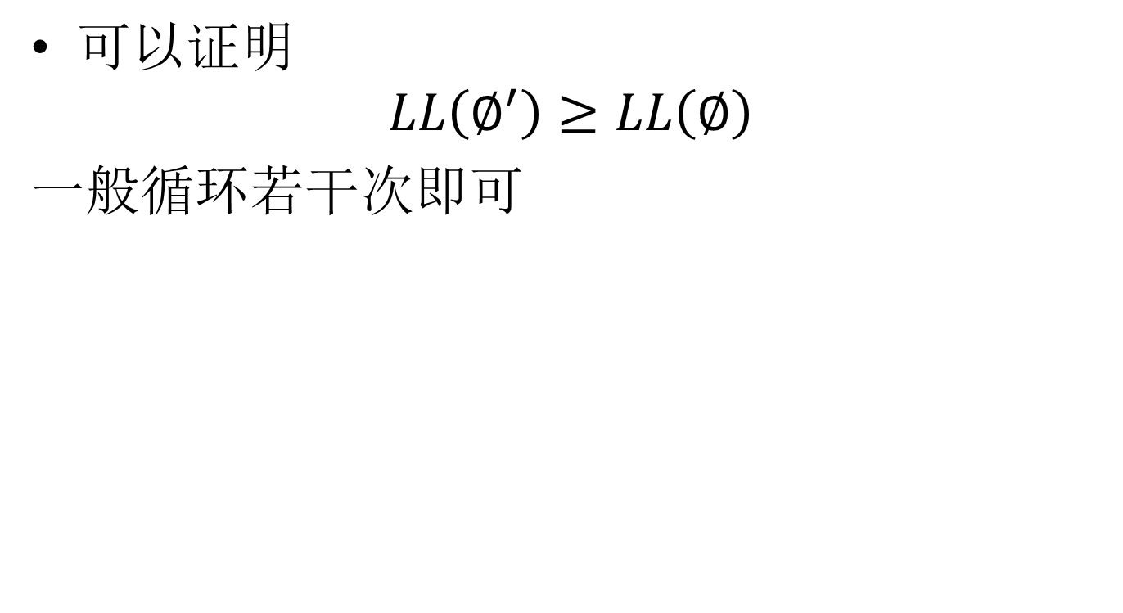

Slide 96
Further Reading 进一步阅读
Notes on the Inside-outside algorithm (非常清晰地解释了算法）
Mark Johnson’s implementation of Inside-outside: http://www.cog.brown.edu/~mj/code/inside-outside.tgz

Slide 97
inside-outside文法训练
inside-outside算法适用于未知文法的归纳（grammar induction），也适用于对已知文法的概率训练
Grammar induction is very interesting topic, but hard. 未知语言的文法归纳是很有意义的事情，也不一定采用CFG，也可以用双语语料库，如吴德恺提出的ITG的文法归纳

Slide 98
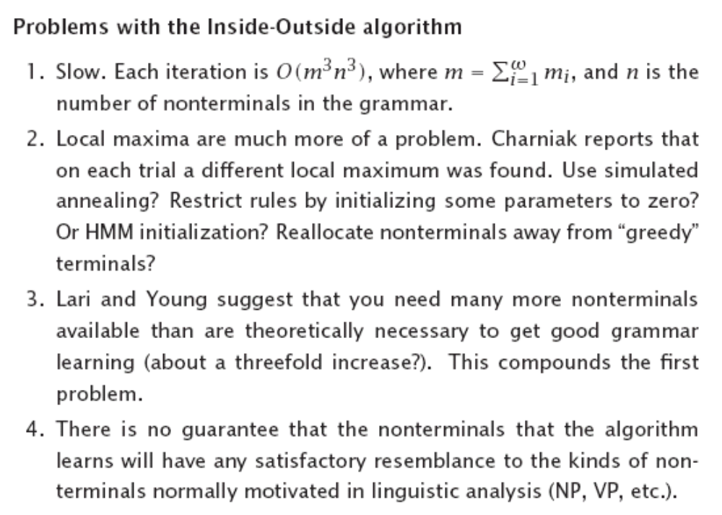

Slide 99
PCFG as a language model
P(s) = Σ_{t} P(t|s), t is a parse tree 分析树，可用这概率作为语言模型
But PCFG LM has not replaced ngram LM. 但是，PCFG语言模型并没有代替n元语言模型，因为（1）对正确的句子，难以得到完全正确的句法树，（2）对不完全合法的句子，得不到句法树
PCFG对小的树赋以高概率，而这也不一定合理

Slide 100
Famous parsers著名句法分析器
There are many excellent work on PCFG parsing,近年来有相当多的工作，国外的著名代表人物是Collins, Charniak，Klein, Manning, Petrov, Socher, etc.
Over 90％ accuracy on Penn Treebank

Slide 101
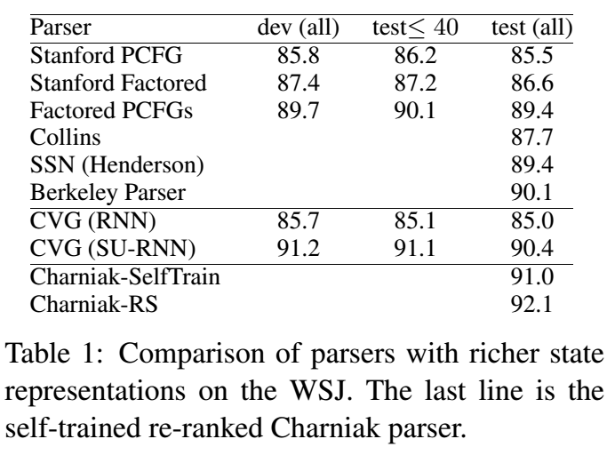
Famous parsers著名句法分析器
Table from Socher 2013

Slide 102
Stanford’s parser
One of the best parses and widely used:
  Dan Klein and Christopher D. Manning. 2003. Accurate Unlexicalized Parsing.
  Dan Klein and Christopher D. Manning. 2003. Fast Exact Inference with a Factored Model for Natural Language Parsing.
http://nlp.stanford.edu/software/lex-parser.shtml

Slide 103
Latent parsing：采用EM算法自动对树库的文法符号进行细分
T. Matsuzaki, Y. Miyao, and J. Tsujii. 2005. Probabilistic CFG with latent annotations. In ACL ’05, p. 75–82.
D. Prescher. 2005. Inducing head-driven PCFGs with latent heads: Refining a tree-bank grammar for parsing. In ECML’05.
Learning Accurate, Compact, and Interpretable Tree Annotation, Slav Petrov, Leon Barrett, Romain Thibaux, and Dan Klein, In proceedings of COLING-ACL 2006.

Slide 104
Andrea Gesmundo, James Henderson, Paola Merlo,Ivan Titov: A Latent Variable Model of Synchronous Syntactic-Semantic Parsing for Multiple Languages, 2009

Slide 105
Berkeley’s parser
Better than Standford parser, over 90% accuracy
http://tomato.banatao.berkeley.edu:8080/parser/parser.html
But the same algorithm performs only at 83% (F1-value) on the Chinese part of the Penn Treebank, much worse than the English part. 但在中文树库的准确率（F值）只有80%，比英文树库的结果差很多

Slide 106
Collins’s parser
Main idea 主要创新点
  Markov grammar
  Distance
  Subcategorization
  Wh movement
3 models

Slide 107
“Markov Grammars”
15% of sentences in test data contain a rule not seen in training data
  No chance of parsing them correctly with the treebank grammar
Instead of fixed grammar rules, we can make up rules (with probabilities) on the fly
  Collins: generate head constituent first; then generate left and right constituents using markov models

Slide 108
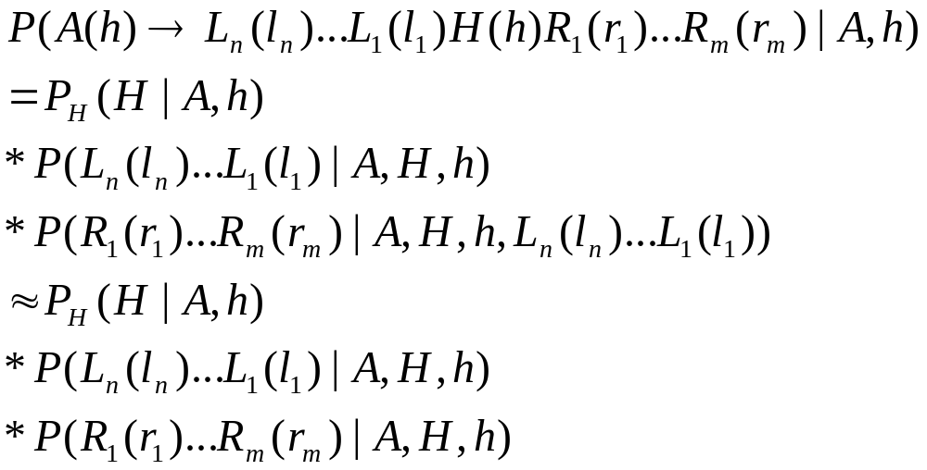
Collins Model 1

Slide 109
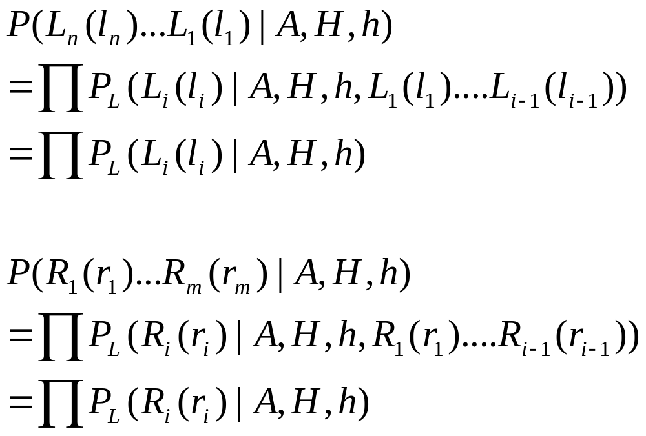
Model 1(cont)

Slide 110
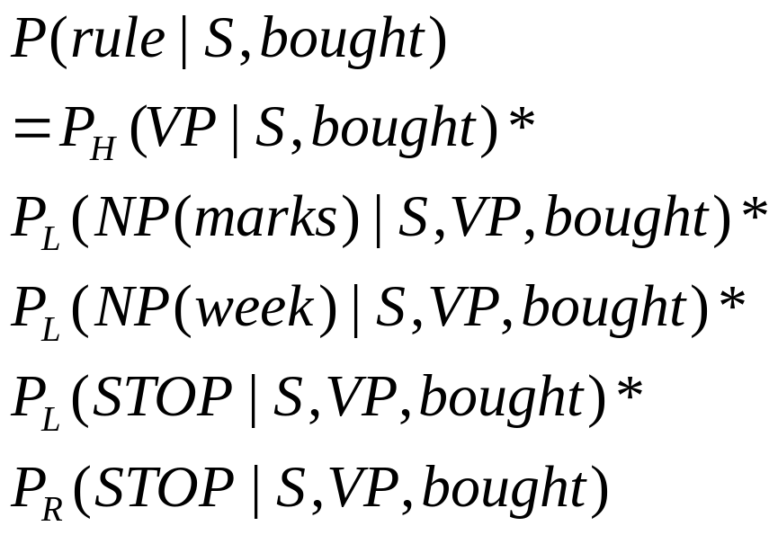
An example
Sentence: Last week Marks bought Brooks.

Slide 111


History based model
在分析树的产生过程中,新的成分的生成与已经生成的成分有关,不是完全独立的

Slide 112
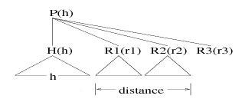
Distance model
英语偏爱右分枝结构;状语很少跨越动词,…
Distance is a function of constituents 距离是以前生成的成分的串的函数:
  zero串长度为0?
  verb串包含动词?

Slide 113
Model 2
Generate a head label H
Choose left and right subcat frames probabilistically
Generate left and right arguments one by one, and remove them from subcat frames
Generate left and right modifiers
The prob of generating STOP when subcat frame is non-empty is 0 and the prob of generating a complement will be 0 if it is not in the in the subcat frame

Slide 114
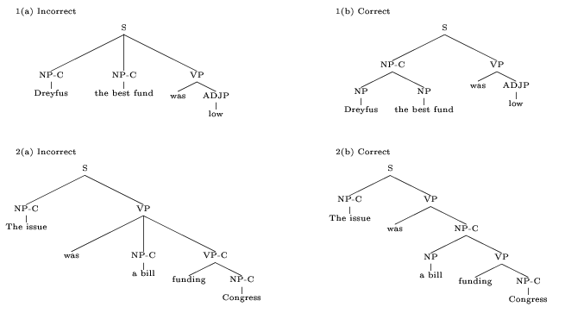
Why subcat frames?
Capture distinctions between complements and adjuncts

Slide 115
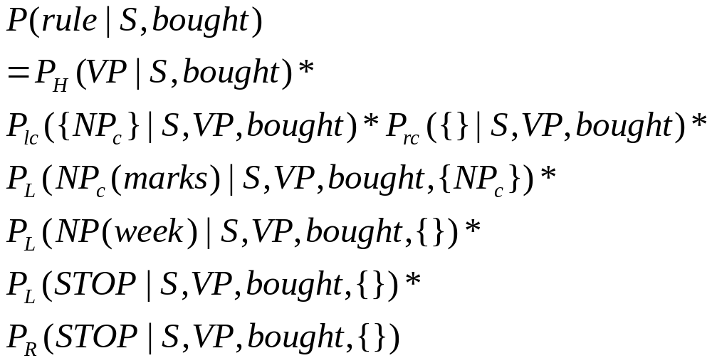
An example

Slide 116
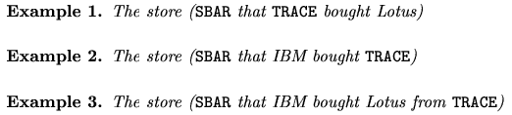
Model 3
Add Trace and wh-movement

Slide 117
Given that the LHS of a rule has a gap, if the gap is not discharged as a trace argument, there are three ways to pass down the gap
  Head: S(+gap)➔NP VP(+gap)
  Left: S(+gap)➔NP(+gap) VP
  Right: SBAR(that)(+gap)➔WHNP(that) S(+gap)

Slide 118
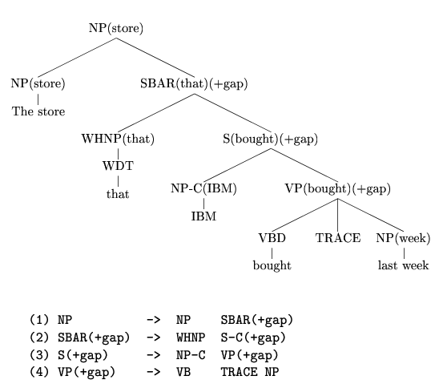

Slide 119
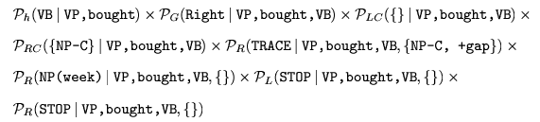
P(VP(bought)(+gap)->VB(bought)TRACE NP(week)) =

Slide 120
Parsing results (<= 40 words)
 | LR | LP
Model 1 | 87.9% | 88.2%
Model 2 | 88.5% | 88.7%
Model 3 | 88.6% | 88.7%

Slide 121
Bikel’s parser
Simplicity of Collins’ model proved to be deceptive, for three main reasons
  Model—like most modern parsing models—relies on a transformed version of Treebank; preprocessing steps contained many hidden details
  Back-off is essential component
    back-off scheme not fully specified for all parameter classes
    subtleties in the use of smoothing weights
  Lexical issues: inconsistent handling of unknown words and special handling of important p(w | t) model
My “clean-room” implementation of Collins’ thesis model: 11% increase in error on §00 of Penn Treebank compared to published results
  at least 3 other attempts by other researchers yielded ≥11% error increase
Reimplemented Collins’s parser and open-sourced it (Java)

Slide 122
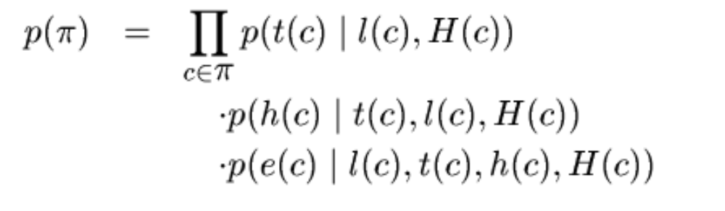
Charniak’s maximum entropy-inspired parser
H(c): context, (History)
t(c): pre-terminal (tag)
h(c): head
e(c): rule, (expansion)
The tag is guessed first 先猜测词性

Slide 123
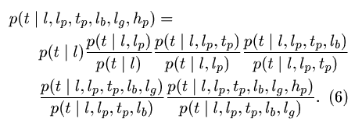
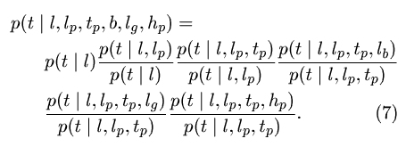
P(t|l,H)
H=l_{p}, t_{p}, h_{p}, l_{b}, l_{g}

Slide 124

Charniak also uses Markov decomposition
0th-order 阶:P(L_{i}|l),P(M|l),P(R_{i}|l)
1st-order 阶: add 加上M
2nd-order 阶: add 加上L_{i-1} R_{i-1}
3rd-order 阶:…
Result 结果: 90.1%

Slide 125
Charniak’s best parser
n-best parsing with discriminative reranking
  Uses global characteristics of trees, not just local rules
  91.0% precision and recall (Charniak & Johnson, 2005，参见mark johnson的主页)
  https://github.com/BLLIP/bllip-parser

Slide 126
Parsing with Compositional Vector Grammars
Compositional Vector Grammar (CVG) combines PCFGs with a syntactically untied recursive neural network that learns syntactico-semantic, compositional vector representations. The CVG improves the PCFG of the Stanford Parser by 3.8% to obtain an F1 score of 90.4%. (Richard Socher 2013)

Slide 127
probabilistic dependency parsing
DP emphasizes relationships between words (no nonterminals!) 依存文法表示的是词和词之间的关系,依存关系避免了对非终集符集合的认定
对词的重视是近年来计算语言学的趋势
依存文法避免了CFG对线性语序的依赖，更接近语义（如谓词论元结构）

Slide 128
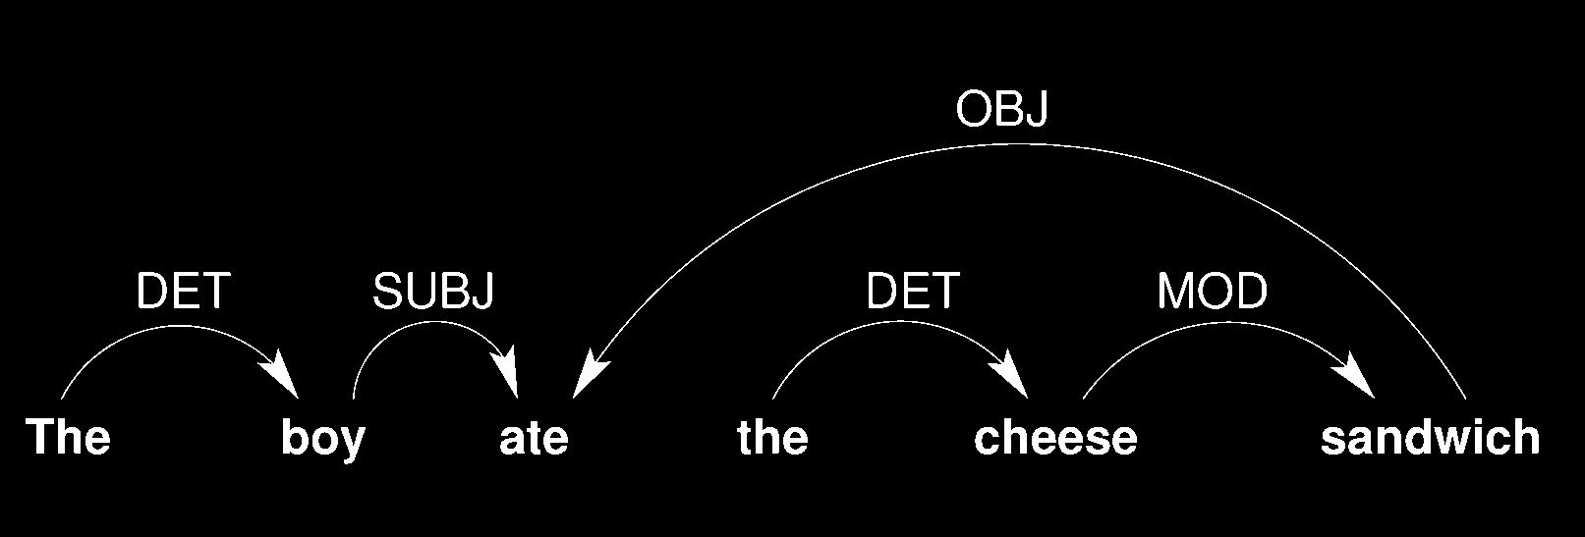
Input: The boy ate the cheese sandwich
Output:
Grammatical Relations (GRs)
Subject, object, adjunct, etc.

Slide 129

Dependency Tree 依存树

Slide 130
Dependency structure: terminology
Label
subj
This is
Child
Dependent
Modifier
Parent
Governor
Head
Note: Most people draw arrows from head to child!

Slide 131
Dependency Axioms
Robinson (1970) formulated four axioms to govern the wellformedness of dependency structures:
  One and only one element is independent.
  All others depend directly on some element.
  No element depends directly on more than one other.
  If A depends directly on B and some element C intervenes between them (in the linear order of the string), then C depends directly on A or B or some other intervening element.

Slide 132
依存公理
七十年代，Robinson提出了依存文法中关于依存关系的四条公理，它们是：
（1） 一个句子中只有一个成分是独立的；
（2） 其他成分直接依存于某一成分；
（3） 任何一个成分都不能依存于两个或两个以上的成分；
（4） 如果A 成分直接依存于B 成分，而C 成分在句子中位于A 和B 之间，那么C或直接依存于A，或直接依存于B，或直接依存于A和B之间的某一成分。
而汉语由于其特殊性，又存在第五条公理【黄昌宁】：
（5） 中心成分左右两边的其他成分相互不发生依存关系。

Slide 133

Projective & nonprojective DG
Dependency grammars that obey the 4 axioms are called Projective. Informally, “projectivity” means the dependency tree does not contain any crossing arcs.
Not all languages satisfies projectivity. 其实语言不一定满足projectivity.

Slide 134


Labelled and Unlabelled DP
  1.Unlabelled: only HEAD is annotated
  2. Syntactic relations (DEPREL) also annotated
  标注语法关系

Slide 135
Evaluation metric
Labelled attachment score (LAS), or Label accuracy
  The percentage of “scoring” token for which the system predicted the correct HEAD and DEPREL value
  A token is “non-scoring” if all characters of the token have the Unicode category property “Punctuation”
    E.g. “.” “,” “?” “(“ “¿” “…” “--” “_” “؟_?” “%” …
Unlabelled attachment score (UAS)
  The percentage of “scoring” token for which the system predicted the correct HEAD value

Slide 136
A Probability model for DP
Formula
P(S,D)=P(D)∏P（w_{i}|w_{j},r,dir)
  S: sentence
  D: dependency structure
  w_{i}: word of S
  r: relation
  dir: direction of dependency
Time complexity O(n³) : Eisner (2000)

Slide 137
My Shift-attach Parser
Developed as early as 1995
Used in my rule-based English-Chinese MT system.
Uses linguistic constraints to make attachment decisions (e.g.副词依赖于形容词,一个动词只有一个主语)
Nbest parsing
Very fast: as fast as over 10,000 sentences per second

Slide 138


McDonald’s Parser
Φ(x): the set of all possible dependency trees over x
McDonald 2006

Slide 139

example

Slide 140

Model 模型
search
    y = argmax y score(x,y)
f: feature vectors 特征向量, w: weights 权重

Slide 141

Maximum Spanning Tree Parsing

Slide 142

Feature functions 特征函数

Slide 143

Weight learning 权重学习

Slide 144

DP: state of the art

Slide 145
Google’s Parser
Announcing SyntaxNet: The World’s Most Accurate Parser Goes Open Source: https://research.googleblog.com/2016/05/announcing-syntaxnet-worlds-most.html
SyntaxNet applies neural networks to the ambiguity problem. An input sentence is processed from left to right, with dependencies between words being incrementally added as each word in the sentence is considered. At each point in processing many decisions may be possible—due to ambiguity—and a neural network gives scores for competing decisions based on their plausibility.

Slide 146

Google’s Parser
SyntaxNet is based on TensorFlow, google’s machine learning and deep neural networks tool using data flow graphs.

Slide 147
Parsing with Richer Formalisms
Parsing with TAG(Tree Adjoining Grammar)
Parsing with CCG (Combinatory Categorial Grammar)
Parsing with HPSG(Head-Driven Phrase Structure Grammar)

Slide 148
Other Parsing works
Data-Oriented-Parsing
  90.7% (Bod, 2004)
Deterministic parsing
  87.6%, but much faster (Sagae & Lavie, 2005)
  3 times faster than Charniak (2000)
Parser Combination by Weigted Voting (Sagae 2006)

Slide 149
国内句法分析工作
哈工大
  刘挺（依存）:公开了资源
复旦
  黄萱菁
清华（周强）：树库
厦大：尚需努力！

Slide 150
homework
Download and play with the following Parsers: Collins’s, or Charniak’s , or Bikel’s , or Stanford，or Berkeley parser.
Implement your own PCFG parser (based on chart parsing or CYK)。Verify that the Parent Annotation method put forward by Mark Johnson can indeed improve the precision and recall (Mark Johnson. 1998. PCFG models of linguistic tree representations. Computational Linguistics, 24:613–632.)

Slide 151
homework
download and play with Google’s SyntaxNet parser. In what way do your think neural networks can benefit parsing?
下载哈工大的汉语依存句库,并据此实现依存文法的概率化句法分析,并把你的结果和他们公开的结果相比较。

